Slide 1
Systems Request
Note Taking Website
Soham Adhikary, Wentao Chen, Kimberly Ho, Kristen Jones, Paul Rajapandi, Catherine Vargas
Deliverable 1: IS 436 - 01

Slide 2
Systems Request
Project Sponsor: IT Manager
Business Need: Create a website for students and those alike to easily create notes using a site.
Reach new customers
Improve already existing similar sites
Alternatives for written note taking
Easy-to-access site
Provide more helpful features than competitors
Create free to use website with premium features

Slide 3
Systems Request
Business Requirements: Create an easy to use site for customers
Create notes from their devices
Able to keep their thoughts in one spot
Save on the go
Design and develop a good e-commerce
Include contact us page for easy to reach advice.

Slide 4
Systems Request
Business value: We expect students and those alike to use this program to easily create notes for school, thoughts, and many more.
Special Issues or Constraints: There are many programs that also similarly allow for note taking. To stand out, this project must create an addition that is unique from all other websites and apps.

Slide 5
Feasibility Analysis
Used for students to have an easy method of note taking
Technically this is a feasible project that will require coding software
ensuring that it will be easy to use for consumers of the site.
Using a contact page
Users are able to give advice or ask questions for further development.
This project will start with a code script and website planning.
Eventually leading to a coding draft and a functional code. This will help create a frontend code draft to complete a running website.

Slide 6
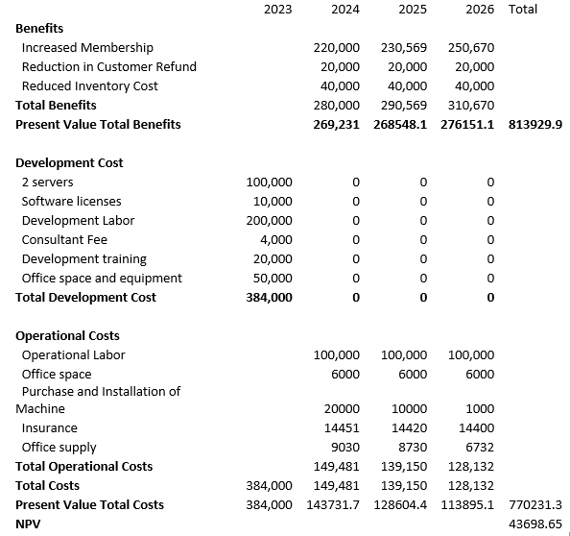
Cost - Benefits Analysis
Total Present benefits: 813929.9
Total Present value: 770231.3
NPV: 43698.65 Positive

Slide 7
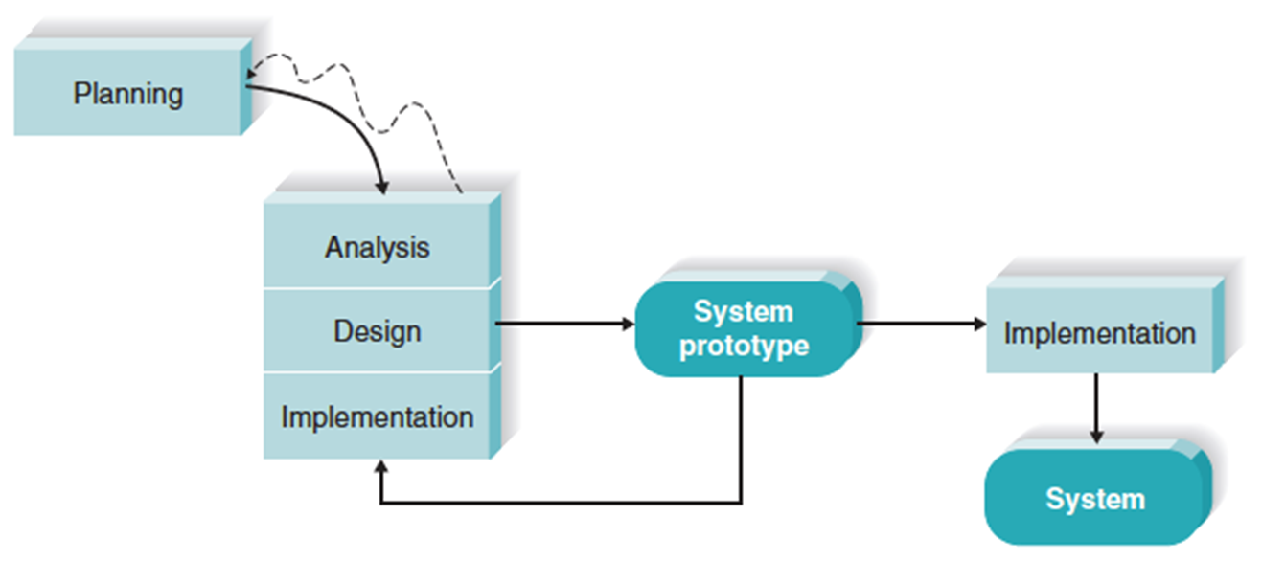
Methodology Selection: Throwaway Prototyping

Slide 8
Why Throwaway Protocol Development?
There is a simplistic way of going about the project
Understanding where the planning phase, the design phase, breaking down the project to get the best results, etc.
Emphasis on trial and error
Throw away things that don’t work and keeping what does
Makes sure every aspect is accounted for in order to get to implementing the system

Slide 9
Project Plan
Deliverable 1 due - 2/26
Begin planning code script and website design
Deliverable 3 due - 3/26
Complete backend code, have frontend code draft completed
Deliverable 5 - 4/23
Add edits, last minute additions or applications
3/12 - 3/25
4/9 - 4/22
Complete Project
2/26 - 3/11
3/26 - 4/8
4/23 - End
Deliverable 2 due - 3/12
Complete coding draft, have a functional code with an approved website design
Deliverable 4 due - 4/9
Complete code, have a running website
Regrouping Meet Ups:
Thursday 1:00 PM & Friday 6:00 PM

Slide 10
Team Roles
Soham Adhikary
Kimberly Ho
Wentao Chen
Project Manager
Data Manager
Frontend Developer
Project Management
Backend Developer
Business Analyst
Catherine Vargas
Paul Rajapandi
Kristen Jones
Data Analyst
Middle Tier Developer
Product Owner

Slide 11
Contact Information
Soham Adhikary :
Wentao Chen :
Kimberly Ho :
Kristen Jones :
Paul Rajapandi :
Catherine Vargas :
sadhika2@umbc.edu
wentaochen@umbc.edu
kho6@umbc.edu
kjones24@umbc.edu
gauthar1@umbc.edu
cvargas1@umbc.edu

Slide 12
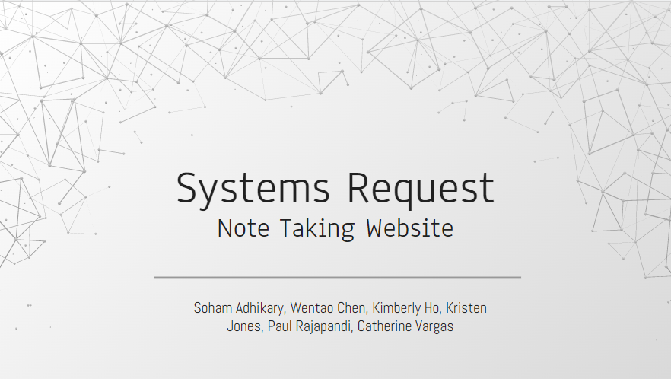
Thank
You

